Slide 1

NETWORKING BASICS 1

Slide 2
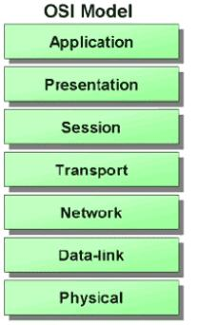
OSI Model

Slide 3
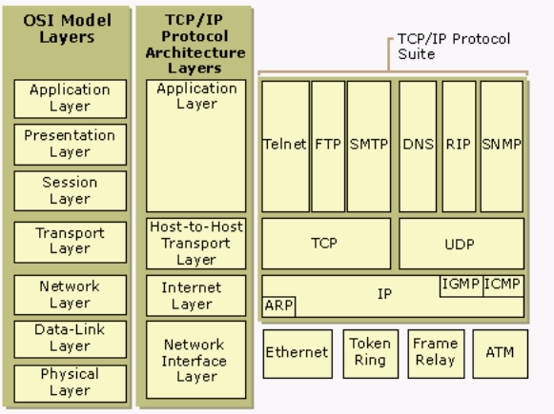
OSI & TCP/IP Model

Slide 4


IP Addressing
74.125.236.34
102 Abbeydale road,
Sheffield S7 1FF
2001:4860:b002::68
www.google.com

Slide 5
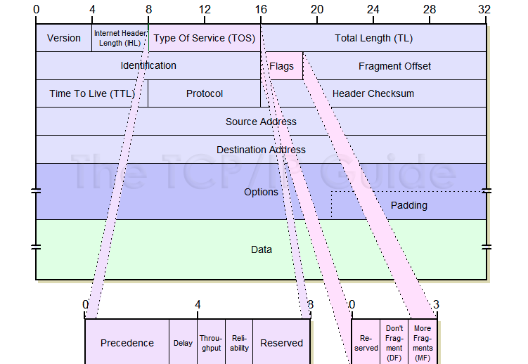
IPv4 header

Slide 6
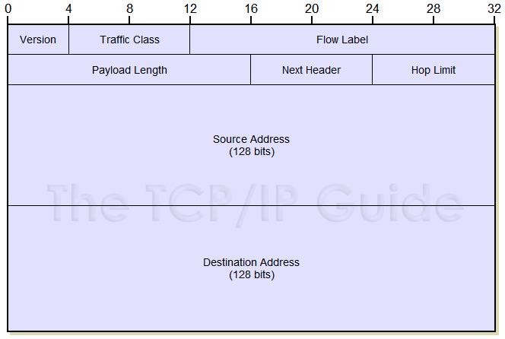
IPv6 header

Slide 7
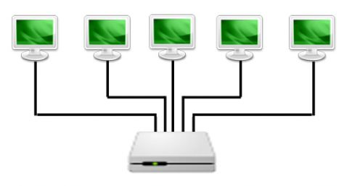

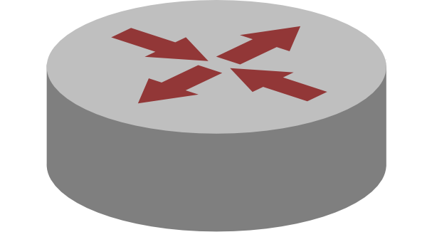
Packet forwarding
Sharing data across systems on a network
Packets forwarded between a source interface and a destination interface, usually on different systems

Slide 8
IP Subnetting
Things to remember before subnetting,
32 bit address
4 octets 8 bits per octet
Class A: 0 to 127
Class B: 128 to 191
Class C: 192 to 223
For instance,
IP address: 172.30.5.82
Mask: 255.255.255.0
Gateway: 172.30.5.1

Slide 9
Practice subnetting 1
Subnetting based on networks:
Need 5 networks from 216.21.5.0

Slide 10
Practice subnetting 2
Need 50 networks from 195.5.20.0

Slide 11
Practice subnetting 3
Need 100 networks from 150.5.0.0

Slide 12
Practice subnetting 4
Need 500 networks from 150.5.0.0

Slide 13
Practice subnetting 5
Subnetting based on hosts:
Need 30 hosts from 216.25.5.0

Slide 14
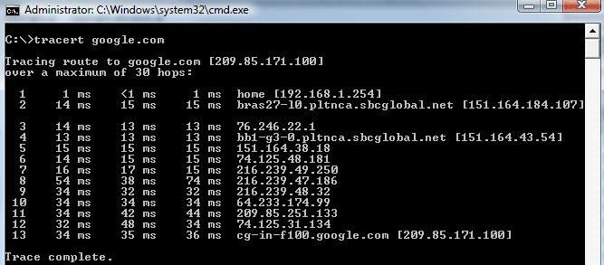
ICMP (ping)
Commonly used to check reachability
Echo-Request and Echo-Reply
Tools like traceroute uses ICMP

Slide 15
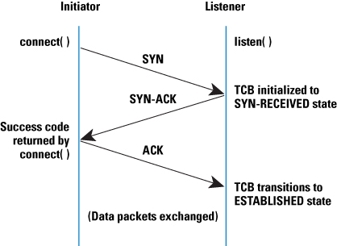

TCP
Reliable, connection-oriented
Used on most applications like file transfer, email, browsing.

Slide 16
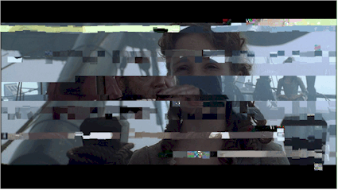
UDP
Unreliable, connection-less
Used on real-time applications like video streaming, VOIP, online games

Slide 17
DNS
Resolves IP address to Name and Name to IP address
DNS server maintains the list of IP address corresponding to their names

Slide 18
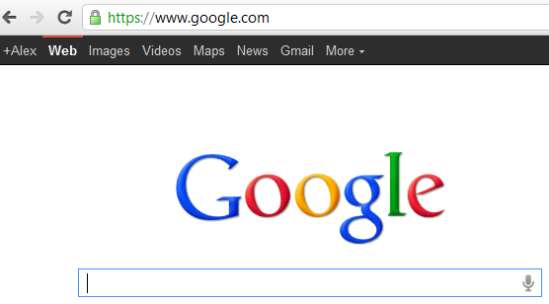
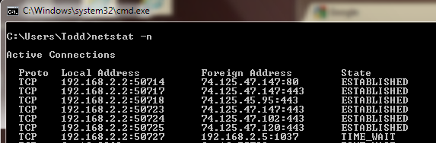

Slide 19
Useful links
ciscoiseasy.com
cbtnuggets.com
subnettingquestions.com

